Slide 1
Product Performance Optimization
Project Guide: Dr. Seema Kolkur

Slide 2
Meet Our Team
Core team members
Gaurav Advani
Saathvik Ayyamolia
Shruti Jain
Drishti Sachwani
Roll no: 1902002
Roll no: 1902007
Roll no: 1902057
Roll no: 1902146

Slide 3
Outline of Topics
Introduction
01
07
Data Processing
02
12
08
Objectives
Design Flow
Literature Review
03
Topics
09
Algorithm
Problem Statement
04
10
Software Details
General Methodology
05
11
Result
Dataset Description
06
12
References

Slide 4
Introduction
The rapid evolution of tools that retrieve, analyze and transform business data have forced organizations to constantly shift and adapt their strategy to unravel consumer behavior. This has emphasized the usage of consumer data to find existing patterns and associations in their actions and characteristics.
Larger organizations gain their competitive advantage by tracking a diverse range of features about their users across their digital platforms to build sophisticated data models.
Conversion Rate Prediction methodology is widely practiced by marketing professionals to score and prioritize users based on their data. The conversion rate for this project is the people who visit the website to the people who sign up and get converted as the leads, bringing them further into the funnel.

Slide 5
Initial pool of leads
Hot leads
Converted leads
Figure 1- Funnel of Leads

Slide 6
Objectives
Collect data and involve data processing to make the obtained data useful to its full potential.
Data Collection and Processing
Analysing the data pertaining to the customers signing up on the X Education website.
Predicting the conversion rate
Analyzing the rate, suggesting methodology to optimize.

Slide 7
Literature Review
In recent decades, there has been a series of research addressing consumers’ behaviour on websites to identify their actions. There are a lot of tools like Google Analytics to generate data detailing customer behaviour.
But, none of them help predict the conversion rates or help suggest optimization techniques based on customer behaviour. There are a few expensive tools like Salesforce, but they are not viable for small businesses or startups who cannot afford them.

Slide 8
Problem Statement
Most websites do not know how they will perform in terms of leads and bringing them into the funnel since they do not know what works out for them the best or who to target. Conversion Rate Predictor helps the marketing specialists to predict the conversion rates of the leads on their website and then give suggestions for optimization to improve the performance.

Slide 9
General Methodology
Input: Dataset of X Education Website
Output: Predicted converted rates based on parameters, recommendations to improve conversion rates
Data Analysis of concerned parameters used to determine conversion rates and performance.

Slide 10
Dataset Description
The dataset has the projections of 9240 leads, 9240 individuals who visited the website.
There are 37 attributes or columns which portrays the customer behaviour. For example, Lead Source, Country, How did you hear about X Education, Total Time Spent on Website, etc.

Slide 11
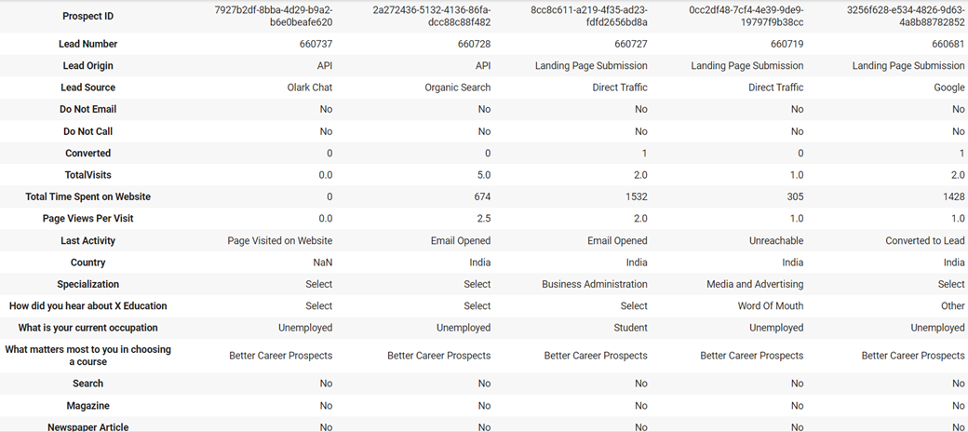
Figure 2- Dataset

Slide 12
Data Processing
The data has been cleaned. Out of the 37 columns, only 29 columns remained after the cleaning process. 6 columns including Lead Quality, Asymmetrique Activity Index, Asymmetrique Profile Index, Asymmetrique Activity Score, Asymmetrique Profile Score and Tags were removed because they had missing values more than 3000.
The 2 remaining columns were Prospect ID and Lead Number. They were removed because they are random and unique for each lead and play no role in the predicting the conversion rates.
For the missing values of the remaining columns, missing data has been replaced with another value, depending the column. For example, for Lead Source, all missing values were replaced with ‘Google’ since it had the highest frequency. The missing values of Total Visits was replaced by its mean value and the missing values in Lead Profile was replaced by ‘Select’. 11 such columns were fixed.
The data has been split into training and testing.

Slide 13
Design Flow
01
03
Dataset
02
Splitting
04
Finding an appropriate dataset
Splitting the dataset into train and test
Processing
Analysing
Cleaning the data and altering the naming conventions
Analysing the data to be trained

Slide 14
Design Flow
05
07
Training
06
Testing
08
Training the Prediction Model using Logistic Regression
Display of ROC curve and Confusion Table
Predicting
Optimization
Using the Testing model to make predictions
Using reliability between different attributes to improve performance and give optimization techniques

Slide 15
Algorithm
Prediction: Logistic Regression (Classification)
The model is built using logistic regression technique. Logistic regression is a statistical classification model that uses a logistics function to model a binary dependent variable in its basic form. It works by predicting categorical values. In this project, the categorical values are whether or not the leads got converted.
Optimization:
For optimization, we have found out the reliability of different attributes contributing to the lead conversion.
The attributes with the highest reliability have been used as an optimization factor in order to better the conversion.

Slide 16
Software Details
Python
Pandas- Pandas provides fast, flexible, and expressive data structures aimed to be the fundamental high-level building block for doing practical, real-world data analysis in the project.
NumPy- Numpy is for N-dimensional array objects and linear algebra
Seaborn- Seaborn will be used for data visualization library based on matplotlib to provide a high-level interface for drawing attractive and informative statistical graphics.
Matplotlib- Matplotlib will be used for creating static, animated, and interactive visualizations of graphs of the threshold.

Slide 17
Result
A dataset has been found. It has been cleaned and split into training and testing. 80% of the dataset will be used for training and 20% for testing. Analysis and training is in process. The conversion rate of the training dataset is 38.6%.
Data has been analysed and optimized based on the reliability of the lead conversion.
Threshold for logistic regression has been found out. Logistic regression has been implemented for prediction.
The model was able to correctly predict the conversion status of 656 leads in the testing dataset, giving an overall accuracy of 84%.
Confusion Table and ROC curve has been implemented to understand the probability and separability of the model.

Slide 18
Result
Reliability = global rate / group mean. If reliability is lower than 1, the group has lower reliability. And if group reliability is round 1, it's not different from global rate. And if it's above 1, it means that it has significantly more reliability that leads will convert their contracts.
Optimization Results:
Housewives and working professionals are most likely to get converted since they have a reliability which is significantly more than one.
The last activity of the leads is relevant if leads are approached upfront, have had a phone conversation or resubscribed to the emails, they are most likely to get converted.
Dual specialization students and lateral students are most likely to get converted.
The leads who have come via references or Welingak website are most likely to get converted.
Flexibility and convenience are important for the leads who are most likely to get converted.
The leads who submit the Lead Add Form and Quick Add Form are most likely to get converted.

Slide 19
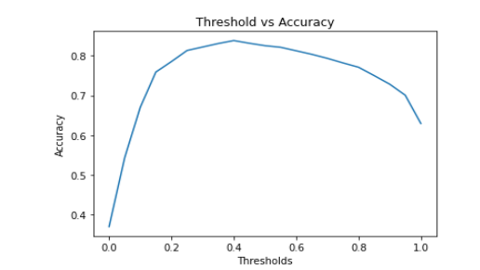
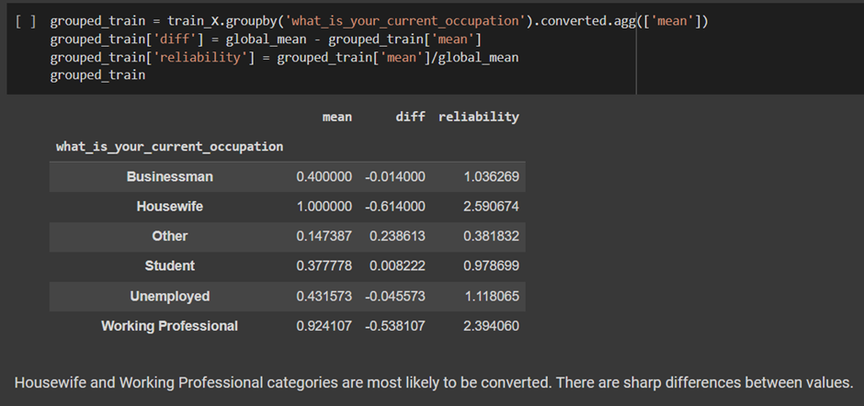
Result
Figure 4- reliability of what_is_your_current_occupation
Figure 3- threshold vs accuracy curve of logistic regression

Slide 20
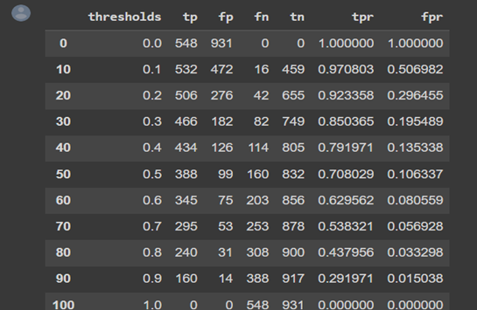
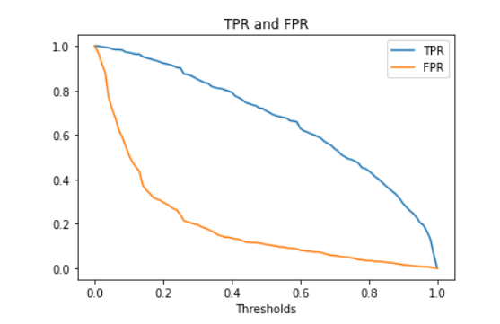
Result
Figure 5- tpr and fpr values
Figure 6- tpr and fpr vs threshold

Slide 21
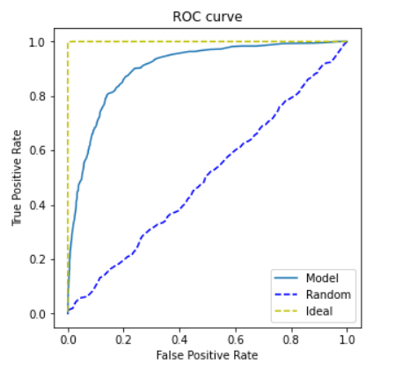
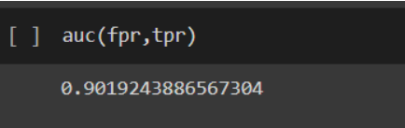
Result
Figure 8- auc value
Figure 7- tpr vs fpr of roc curve

Slide 22
References
[1] Dietmar, J., & Matle L.(2017). Investigating Personalized Search in E-Commerce. Association for the Advancement of Artificial Intelligence, www.aaai.org
[2] Pappas, I. O., Kourouthanassis, P. E., Giannakos, M.N., & Chrissikopoulous, V. (2017). The interplay of online shopping motivations and experiential factors on personalized e-commerce: A complexity theory approach. Telematics and Informatics, 34, 730-742
[3] Fan, Z., & Sagar, S. K. (2006). Predicting Online Customer Shopping Behavior. Emerging Trends and Challenges in Information Technology Management, ½ Gefen, D., Darahanna, E., & Straub, D.W. (2003). Trust and TAM in online shopping: An integrated model. MIS Quarterly, 27(1), 51-90
[4] QuanLu, Shengjun Pan, LiangWang, Junwei Pan, FengdanWan and Hongxia Yang. 2017. A Practical Framework of Conversion Rate Prediction for Online Display Advertising. In Proceedings of .e 23rd ACM SIGKDD Conference on Knowledge Discovery and Data Mining’, Halifax, Nova Scotia - Canada, July 2017 (KDD), 9 pages.

Slide 23
References
[5] T. Hastie, R. Tibshirani and J. Friedman, ”Fitting Logistic Regression Models,” i The Elements of Statistical Learning: Data Mining, Inference, and Prediction, Second Edition, Springer, 2016, pp. 120-121.
[6] S. Lemeshow and D. W. Hosmer, ”Model building strategies and methods for logistic regression,” i Applied logistic regression, New York, John Wiley & Sons, INC, 2000, p. 93
[7] Bertelsen, S. M. (2012). Conversion Rate Optimisation: Barriers to Adoption. Master Thesis, IT University of Copenhagen, Digital Design and Communication, Copenhagen. Retrieved March 5, 2019, from https://crothesis.files.wordpress.com/2013/01/conversion-rate-optimisation-barriersto-adoption_sisse-bertelsen.pdf
[8] Croxen-John, D., & Tonder, J. v. (2017). E-Commerce Website Optimization: Why 95% of Your Website Visitors Don't Buy, and What You Can Do About it. Kogan Page Ltd.
[9] Shukairy, A. (2017, February 24). What is Conversion Rate Optimization (CRO) and Why Is It Important? Retrieved from www.invespcro.com: https://www.invespcro.com/blog/what-is-conversion-rate-optimization/

Slide 24
References
[10] Andrus, A. 2020. What is Conversion Rate? How to Calculate and Improve Your Conversion Rate. Disruptive Advertising. Retrieved on 11 August 2020. Available at: https://www.disruptiveadvertising.com/conversion-rate-optimization/conversion-rate/
[11] Saleem, H & Uddin, M. K. S. & Habib-ur-Rehman, S & Saleem, S & Aslam, A. M. 2019. Strategic Data Driven Approach to Improve Conversion Rates and Sales Performance of e-Commerce Websites. International Journal of Scientific & Engineering Research. Retrieved on 10 August 2020. Available at: https://www.citefactor.org/journal/pdf/Strategic-Data-Driven-Approach-to-ImproveConversion-Rates-and-Sales-Performance-of-E-Commerce-Websites.pdf
[12] Berezhnaya, Anastasia 2016 “Conversion Rate Optimization: Visual Neuro Programming Principles (Bachelor Thesis Helsinki Metropolia University of Applied Science)
[13] H Bryan 2013 Conversion Marketing: Convert Website Visitors to Buyers (AudioInk Publishing)
[14] P Soonsawad 2013 Developing New Model for Conversion Rate Optimization: A Case Study (International Journal of Business and Management) vol 8 no 10 pp 41-51.

